Slide 1
Drug Prescription and Analysis using Machine Learning
Team Members:
Aryaman Mishra (19BCE1027)
Raghav Somani (19BCE1027)
Siddharth Mehta (19BCE1485)

Slide 2
Content Of This Template
• Abstract
• Introduction
• Literature Review
• Project Description
Modules
• Tools used
• References
.

Slide 3
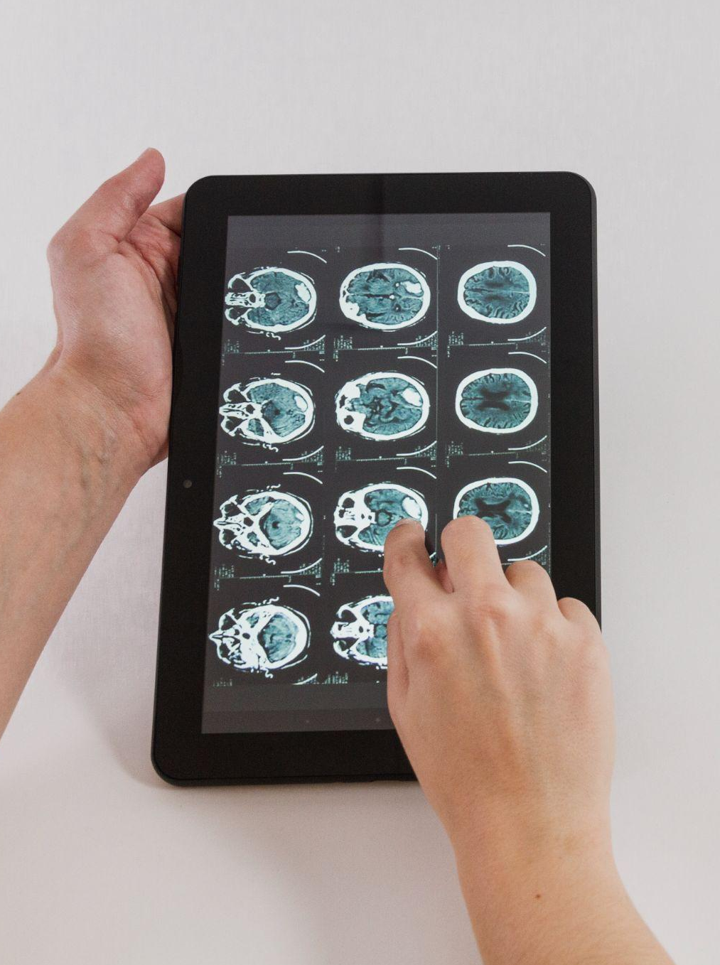
Abstract
Prescription of accurate drugs is one of the most important therapeutic transaction between physician and patient. It is a health care program implemented by a physician in the form of instructions that govern the plan care for an individual patient. It is a written order for the medication to be used for diagnosis prevention and treatment of specific patient directed by physician. It is a crucial task and suggests prescriber’s responsibility towards the clinical care and the safe monitoring of the patient thus also carries legal implication.
Our objective in this project is to ensure that the patient gets information about the right medicine and right dose easily and accurately.

Slide 4
02
Introduction

Slide 5
Introduction
The resemblance of our WEBSITE will be similar to that of a local medical facility with options to contact and schedule appointments hence understanding the concept of data visualization in drugs with their usefulness.
We will be creating a web application with the help of NLP Techniques coupled with Machine Learning algorithms which will be used to prescribe certain drugs and medicines based on objective reviews from multiple users.
These reviews will be defined in a dataset which contains the name of drugs along with User ID and a review. Using the review column we will be analyzing the sentiment of the review and will be categorizing the drugs from best to worst.
The website will provide links to buy the medicines generated by our algorithm. We will also be integrating a chat bot using an NLP Algorithm which will communicate in a user-friendly manner and deliver the expected knowledge about hospitals and drugs to treat the most common infections/diseases present in today’s era
The dataset being used will contain over 80000 reviews to determine the best course of action and will dissipate needless commercial reviews and replace them by reviews by ordinary people which are known for saying the objective truth regarding the product despite their marketing, which is very common for most products on various e-commerce sites. Hence the project will be focusing on some important modules in this field.

Slide 6
Literature Review
PRIOR WORK:
In Prior studies,Jennifer Corny, Asok Rajkumar, Olivier Martin, Xavier Dode, Jean-Patrick Lajonchère, Olivier Billuart, Yvonnick Bézie, Anne Buronfosse,used the same dataset to conduct a brief study on the dataset collected by pharmacists for over a period of 18 months to identify prescription with high risk of errors.
Data from electronic health records were collected over a period of 18 months. Inferred scores at a patient level (probability of a patient’s set of active orders to require a pharmacist review) were calculated using a hybrid approach (machine learning and a rule-based expert system).
A clinical pharmacist analyzed randomly selected prescription orders over a 2-week period to corroborate our findings. Predicted scores were compared with the pharmacist’s review using the area under the receiving operating characteristic curve and area under the precision recall curve.
These metrics were compared with existing tools: computerized alerts generated by a clinical decision support (CDS) system and a literature-based multicriteria query prioritization technique.
Data from 10716 individual patients (133179 prescription orders) were used to train the algorithm on the basis of 25 features in a development dataset.

Slide 7
Literature Review
Incorrect use of drugs
Detecting polypharmacy from drug prescription records point at incorrect use of medicines. These incorrect use are mainly tesult of rough and imperfect suggestions from online forums,local peers and illicit pharmacists.
According to estimates by the World Health Organisation (WHO) more than half of all medicines are prescribed, dispensed or sold inappropriately, and that half of all patients fail to take them correctly (WHO, 2012).
In the scope of the third global patient safety challenge, WHO addresses three areas of medication-related harm—i.e., high-risk situations, polypharmacy and transitions of care (Sheikh et al., 2017).
With the rapid introduction of the electronic health records (EHR), particularly at the primary healthcare level, it will be possible to effectively monitor and identify groups of patients or individuals at high risk for drug-induced or related health problems (Molokhia & Majeed, 2017).
A great majority of studies on pharmacy have focused on its potential negative consequences, e.g., nonadherence, interactions, and adverse drug reactions. Some researchers have also considered the effectiveness of interventions aimed at reducing polypharmacy, however, the factors and conditions leading to polypharmacy have received comparatively little attention.
These factors can be broadly classified into four groups:
factors related to the health care system (e.g., life expectancy and novel therapies),
factors related to patients (e.g., age and clinical conditions),
factors related to physicians (e.g., guidelines and prescribing habits), and
the interaction between patient and physician.

Slide 8
Literature Review
MATERIALS
In our study, we focused on drug prescription more specifically reviews on medications,given by online forum users taken within the pharmaceutical field.
Online user reviews in this domain contain information related to multiple aspects such as effectiveness of drugs and side effects, which make automatic analysis very interesting but also challenging.
The data was collected during 2017-18. Machine learning is becoming indispensable for solving problems in many disciplines, including healthcare.
At the moment, we are witnessing the introduction of various machine learning approaches in different fields of healthcare that can help the professionals in improvement of diagnosis or prognosis and even displacing a lot of work done by radiologists and anatomical pathologists (Obermeyer & Emanuel, 2016). However, despite the ever-increasing prediction performance of the novel predictive modelling techniques, most of them still lack interpretability to offer actionable support for healthcare experts (Holzinger et al., 2017; Stiglic et al., 2012).
Therefore, this study aims to offer more insight into balancing the interpretability and predictive performance of the drugs in healthcare.
More specifically, we evaluate different levels of user satisfaction based on there reviews on drugs for different diseases,and suggest which drugs are best and worst for a disease.Evaluation is based on user review.

Slide 9
Project Description
The proposed system is using a Database for storing information. In regular database systems, sometimes because of existence of huge data it is not possible to fulfill the user's criteria and to provide them with the exact the information that they need to make a decision. These huge record sets can be processed and learned for better and automated medication. So, this can be done with machine learning systems to evaluate the patient, diagnose them and to prescribe them with medicine. With big data growth in biomedical and healthcare communities, this can be overcome by providing more accurate analysis. So, using machine learning algorithms effective prediction of diseases can be done and providing with precise medicine for the disease.
This system built using machine learning is developed with huge number of patient records. So, with these huge record sets a machine can be built which can learn those data, cluster them, classify them and extract them whenever in need. So, by using various machine learning algorithms we can train a System with those data. So, it does something more than a normal database system which can only be referred rather than making a study over those data. Entirely for the prediction of the human diseases and prescribing solution. So, the entire activities of the system must be under the surveillance of an expert Doctor who have a detailed knowledge in the field of medicine.

Slide 10
Project Description
3.The interaction between the patient, admin and prescription service is planned to be organized through a web portal. The patient visits the website for taking the necessary treatment of the infected diseases. In order to do this, the patient approaches the admin for the basic procedures to proceed with the treatment. The patient details and symptoms are registered that they are suffering from. It generates a unique ID after the submission of the registered form. The PHR’s are stored in the cloud database where it is provided with the security to the patient’s records as they contain the sensitive information. With reference to the ID the patient consults the doctor where the particular patient record is retrieved from the database. The patient’s details are stored in the cloud database where it is provided with the security to the patient’s records as they contain the sensitive information.
Here we have built an AI system where we can give our symptoms so that it can give us the disease and the drug prescription for the disease. Various details are given to this application so it can process those data for optimal outcome. Mostly the application gets the symptoms and issues of the user. Once the input is given the processing of the data takes place to identify the disease and to give the drugs for the appropriate disease. So here to get the accurate disease prediction we use Naïve Bayes and NLP algorithms which are associated with the patient’s details. So, with these result the user can take immediate action and for further treatment can consult the doctor.

Slide 11
Modules
Python Notebook for Data Visualization and Prediction of Drug Usefulness.
Client Program for users to seek best medicines for any medical condition.
Front-End Website for Module Integration.
Excel Dashboard using Splicer for additional Data Visualization.
AI-Powered Chatbot to guide new users and give information on drugs.

Slide 12
Tools Used
Jupyter Notebook
Microsoft Excel 2016
IBM Watson AI Assistant
Snatchbot
Python Anywhere
HTML-CSS Front End Web Tools
Anvil
Adobe Dreamweaver

Slide 13
References
https://pdf.sciencedirectassets.com/271027/1-s2.0-S0735109705X03552/1-s2.0-S0735109705027191/main.pdf?
https://benthamscience.com/journals/current-drug-research-reviews/
https://www.rroij.com/drug-delivery.php
https://www.journals.elsevier.com/advanced-drug-delivery-reviews
https://www.nature.com/nrd/

